Slide 1
IBM University Engagement Project Submission
“Exploring the Power of Agentic AI with IBM Granite and LangFlow”

Slide 2

Project Tile – Interview Trainer Agent
Domain of Project – Education
Student Name | Recent Passport Photo | Email ID | Mobile number [WhatsApp]
Subham Kumar |  | subhamkumar5456@gmail.com | +91 6299102243

Slide 3
Problem Statement - Interview Trainer Agent
The Challenge
Cracking a job interview is a critical yet under-prepared milestone. Candidates struggle with role-specific questions, structuring responses, and benchmarking against industry standards. Resources are scattered, rarely personalized, and never adaptive — leaving most underprepared not from lack of skill, but lack of structured practice and feedback.
The Objective
Build an AI-powered Interview Trainer Agent delivering personalized, role-specific preparation for freshers, experienced professionals, and career-switchers.
Personalized Question Generation — Tailored questions based on resume, job title, experience level, target company, and domain.
RAG-Based Knowledge Retrieval — Role-specific questions, behavioral scenarios, and industry expectations from recruitment portals and company databases.
Model Answers & Feedback — Structured sample answers (STAR framework) with actionable improvement tips.
Technical & Soft Skill Assessment — Domain-specific technical questions plus behavioral/situational scenarios.
Progress Tracking — Track mock sessions, highlight improvement areas, and simulate real interview environments.
Multi-Agent System: Profile Analysis · Question Retrieval · Answer Evaluation · Behavioral Coach agents.
Visualization Dashboard — Readiness scores, mock session history, and improvement areas.

Slide 4
Proposed Solution -
Proposed Solution: AI-Powered Interview Trainer Agent
The proposed solution is a multi-agent AI-powered Interview Trainer Agent built using LangFlow, IBM watsonx.ai, and Granite Models to provide personalized, role-specific interview preparation for candidates across experience levels and industry domains. The system addresses challenges in question discovery, response structuring, and confidence building through an intelligent, modular architecture.
At its core, the solution uses a Retrieval-Augmented Generation (RAG) pipeline to fetch relevant interview questions, behavioral scenarios, HR guidelines, and industry expectations from trusted sources such as recruitment portals, professional networking platforms, and company-specific interview databases. This data is embedded and stored in a vector database, enabling the system to retrieve and surface the most relevant, role-targeted preparation material using Granite models.
The system consists of four key agents:
Profile Analysis Agent parses the user's resume or job title input to extract key skills, experience level, technology stack, and potential skill gaps, forming the personalized context for all downstream agents.
Question Retrieval Agent uses RAG to fetch and rank role-specific technical questions, domain knowledge checks, and situational HR questions tailored to the candidate's target job and industry.
Answer Evaluation Agent assesses the candidate's responses using structured frameworks (such as STAR), provides scores, highlights strengths and weaknesses, and delivers actionable improvement tips.
Behavioral Coach Agent generates soft-skill and behavioral interview scenarios, simulates HR round conversations, and coaches the candidate on communication, tone, and professional articulation.

Slide 5
Technology Used
Langflow Platform – For designing and orchestrating the multi-agent interview trainer workflows visually, connecting the Profile Analysis, Question Retrieval, Answer Evaluation, and Behavioral Coach agents seamlessly.
IBM Granite Model – for eg – ibm-granite-3-2-8b – For natural language understanding, question generation, response evaluation, and personalized interview coaching.
IBM Cloud – It provides the infrastructure to build, deploy, and scale the Interview Trainer Agent efficiently. IBM Cloud enables a reliable, secure, and scalable environment for deploying the Interview Trainer Agent.
RAG – RAG to fetch real interview data first, then generate intelligent, role-specific questions and answers, making the Interview Trainer Agent more accurate, trustworthy, and industry-aligned.
IBM Watsonx.ai – For model deployment, embeddings, and AI governance, ensuring responsible and scalable AI-powered interview preparation.
Vector Database (FAISS/Chroma) – For RAG-based retrieval of role-specific interview questions, behavioral scenarios, HR guidelines, and company interview patterns from indexed knowledge sources.

Slide 6
Langflow component Used -
Chat Input — Users paste/upload their resume, select target role, interview type, and number of questions before submitting.
IBM watsonx AI Agent — Processes sanitised resume and RAG-retrieved context using IBM Granite to generate questions (Call 1) and score all answers in a single batch call (Call 2).
IBM Granite Model — ibm/granite-3-3-8b-instruct— Fast, instruction-tuned for real-time question generation and answer scoring. Optional: ibm/granite-guardian-3-8b for safety verification.
Chat Output — Displays AI-generated performance report with per-question scores, bar chart, feedback, model answers, top strengths, and improvement areas.
File Component — data/questions.json — 45 hand-curated questions across 3 roles and 3 interview types, loaded into ChromaDB at startup for RAG retrieval.
ChromaDB Vector Store — Local vector database embedding the question bank usingall-MiniLM-L6-v2, serving the top 8 semantic matches for question grounding.
Prompt Template — Builds system and user prompts for both LLM calls (question generation + batch scoring) with injection-safe <answer id="…"> wrapping.
Input Guardrails Node — Validates resume input through length check, injection detection, content safety, PII redaction, and rate-limit gate before any LLM call.
Per-Answer Guardrails Node — Checks every answer for length, injection, and content safety before the batch call. Blocked answers are scored 0 without reaching the model.
Rate Limiter — Enforces a hard budget of 2 LLM calls per session with a 2-second minimum gap between calls.

Slide 7
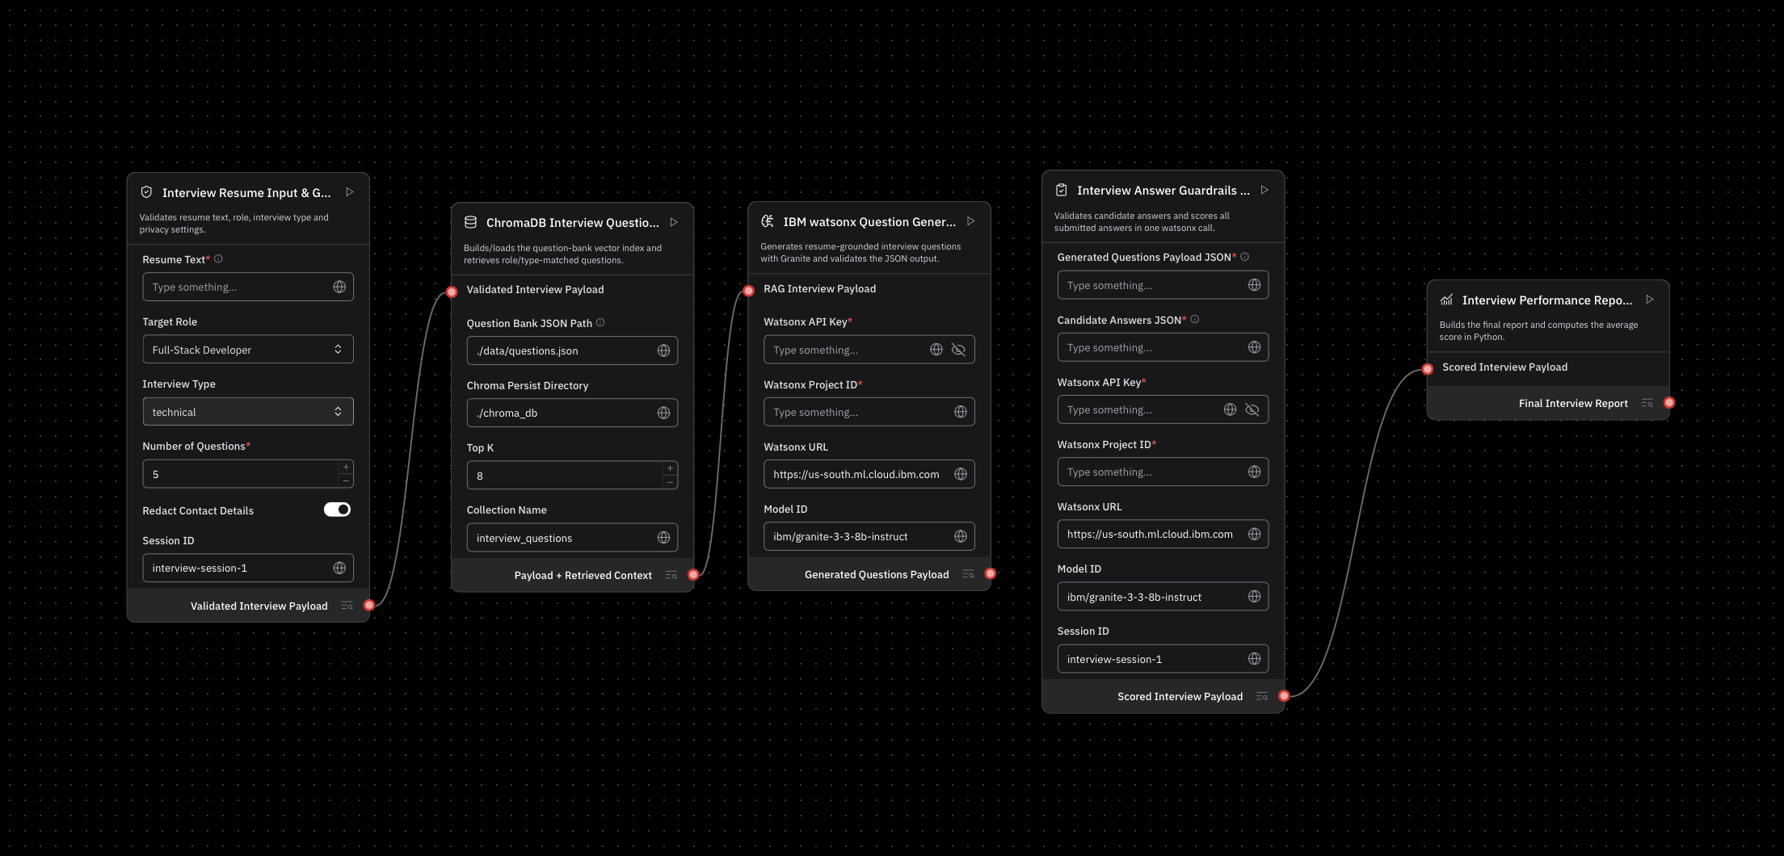
Langflow workflow -

Slide 8
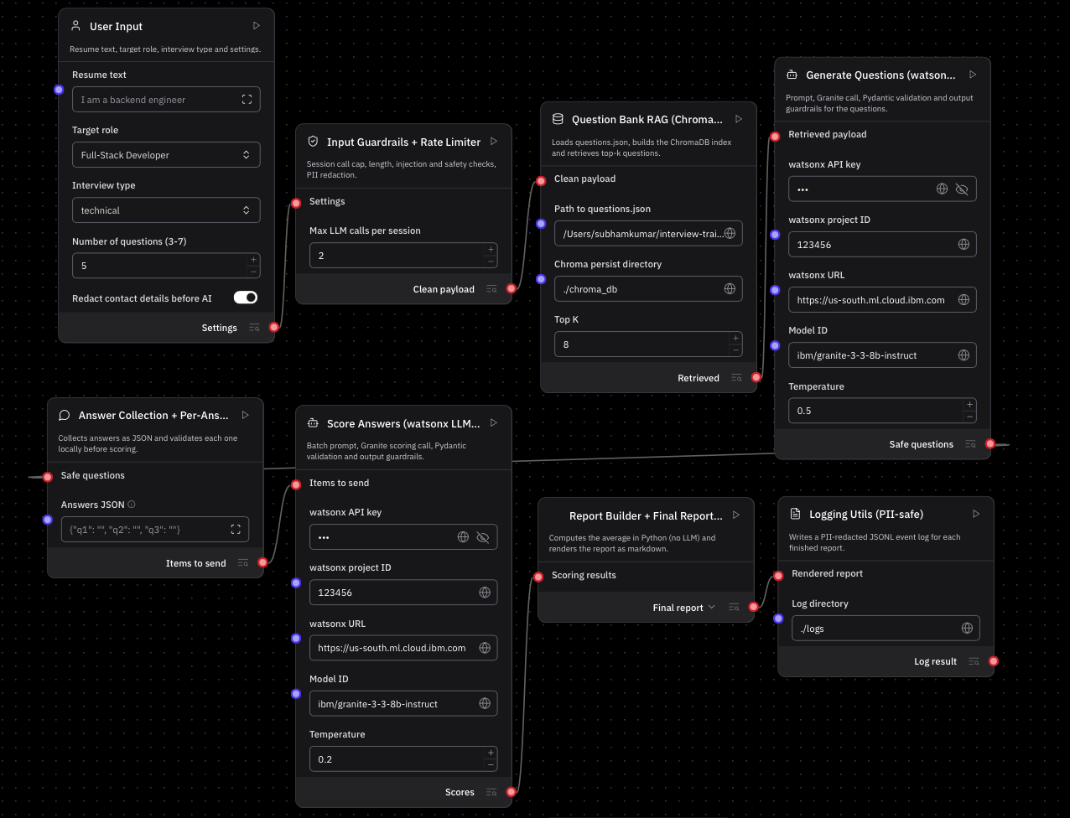
Architecture blueprint

Slide 9

Role of Agentic AI in the solution
Agentic AI makes the Interview Trainer intelligent, autonomous, and personalized through coordinated AI agents that perceive context, reason over knowledge, and act autonomously.
Profile Analysis Agent — Parses resume + target role; extracts skills and experience signals to drive all downstream decisions.
Question Generation Agent (agent.py → generate_questions) — Uses RAG (ChromaDB + embeddings) + IBM Granite to retrieve and generate tailored questions across technical, behavioral, and mixed types.
Answer Evaluation Agent (agent.py → score_answer) — Scores responses (0–10), generates structured feedback, model answers, and key point coverage — validated via Pydantic v2.
Guardrail & Safety Agent (guardrails.py) — 10-category pipeline guardrails: input validation, PII redaction, injection detection, bias filtering, grounding checks — optionally backed by IBM Granite Guardian.
Report Generation Agent (agent.py → generate_report) — Aggregates scores, surfaces strengths and improvement areas, produces a structured final report on the Streamlit dashboard.
These agents form an orchestrated end-to-end pipeline — from resume parsing through scoring, safety enforcement, and reporting — with minimal human oversight.

Slide 10
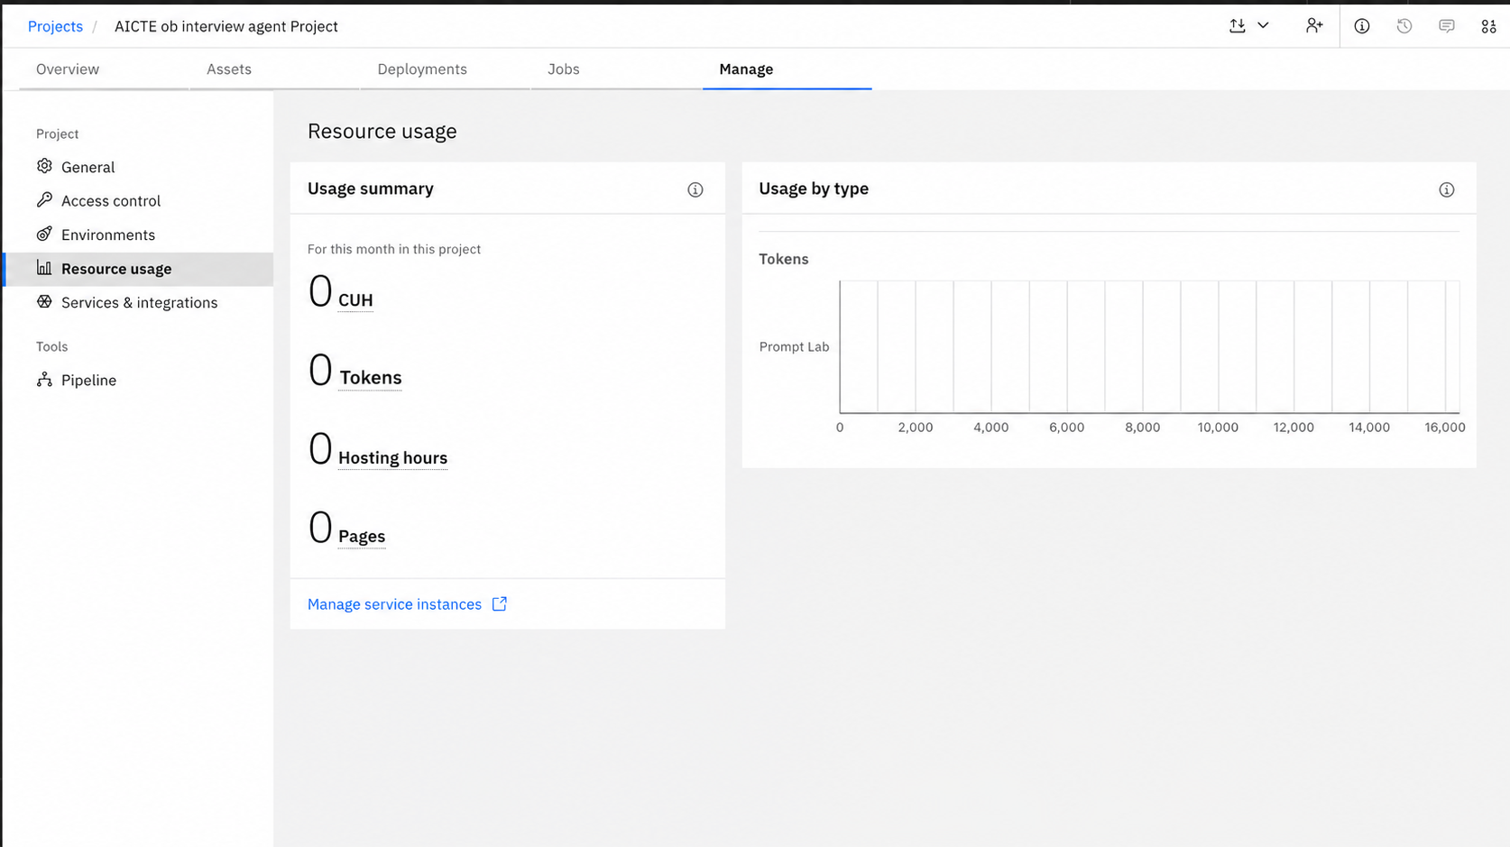
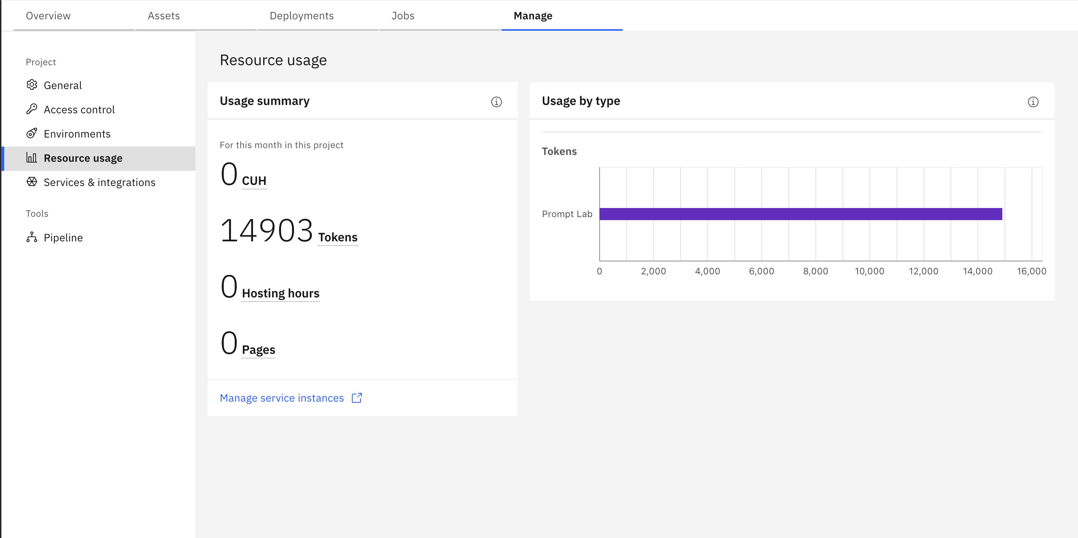
Token Usage
14,903 token are used
Before Prompt
After the Prompt
·
·
·

Slide 11
Novelty and Uniqueness
The proposed Interview Trainer Agent stands out by combining Agentic AI, RAG, and a 10-category guardrail system into a single intelligent interview preparation platform.
Multi-Agent Intelligence – Instead of a single chatbot, multiple specialized agents — for question generation, answer evaluation, safety enforcement, and report generation — collaborate to deliver accurate, context-aware interview coaching.
RAG-Based Accuracy – Integrates real-time retrieval from a curated question bank (ChromaDB) with IBM Granite generation, reducing hallucinations and ensuring every question is grounded in real, role-specific interview data.
Resume-Aware Personalization – Tailors interview questions directly from the candidate's uploaded resume, targeting their exact skills, experience level, and target role — not generic templates.
Structured Answer Evaluation – Goes beyond simple feedback by scoring responses 0–10, identifying covered and missed key points, and delivering a model answer — all through Pydantic-validated structured outputs.
Built-In Fairness & Safety – A unique 10-category guardrail system covering PII redaction, bias filtering, prompt injection detection, and illegal question prevention — making it one of the most responsibly built interview tools available.
Scalable & Enterprise-Ready – Built on IBM watsonx.ai with IBM Granite models, ensuring reliability, AI governance, and scalability from individual use to institutional deployment.
This makes the solution a smart, adaptive, and responsible AI interview coach — not just a static question bank or a generic chatbot.

Slide 12
Git Hub Link
(https://github.com/subhamkumar5456/Aicte-Interview-Trainer-Agent)
·
·
·

Slide 13
Future Scope
Future Enhancements
Live Interview Simulation & Real-Time Feedback — Extend with live mock interview sessions where users speak their answers and receive real-time feedback on content, tone, and delivery. Integrating speech-to-text and sentiment analysis enables the agent to evaluate confidence, clarity, and communication skills — beyond just answer content.
AI-Powered Voice Assistant & Multilingual Support — Add a voice-enabled assistant with support for multiple languages, allowing users to interact naturally in their preferred language. This improves accessibility and makes the solution more inclusive for diverse populations across different regions and linguistic backgrounds.
Company-Specific Interview Preparation — Expand the RAG pipeline to index company-specific interview patterns, culture-fit questions, and hiring bar expectations from platforms like Glassdoor and LinkedIn — tailoring preparation not just by role, but by target company for a sharper competitive edge.
Resume Gap Analysis & Skill Roadmap — Include an intelligent gap analysis feature that compares the user's resume against a target job description, identifies missing skills, and recommends a personalized learning roadmap — turning the Interview Trainer into a full career development assistant.
Persistent Progress Tracking & Leaderboards — Add server-side session persistence so users can track improvement across multiple sessions, revisit past mock interviews, and benchmark readiness scores against peers — motivating consistent practice and measurable growth over time.
·
·

Slide 14
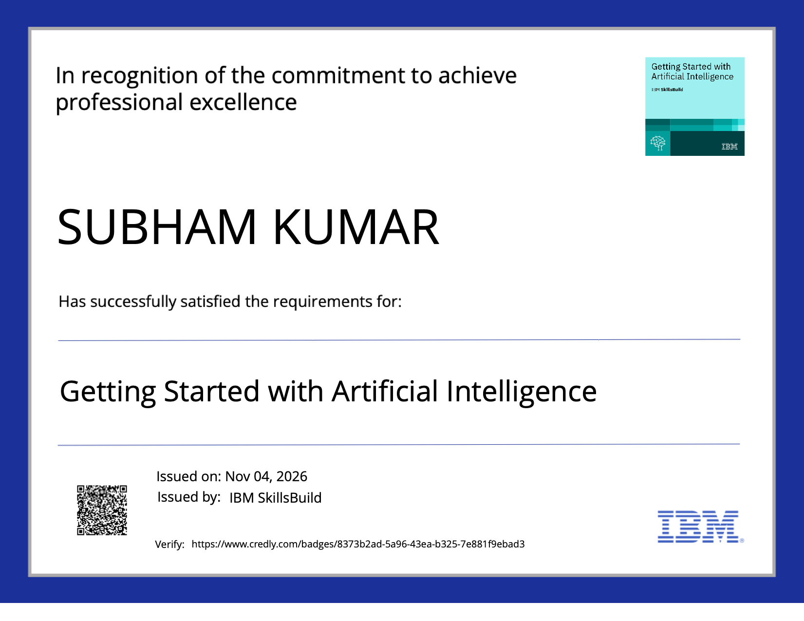
Certificates Earned:
Please add your credly certificate

Slide 15
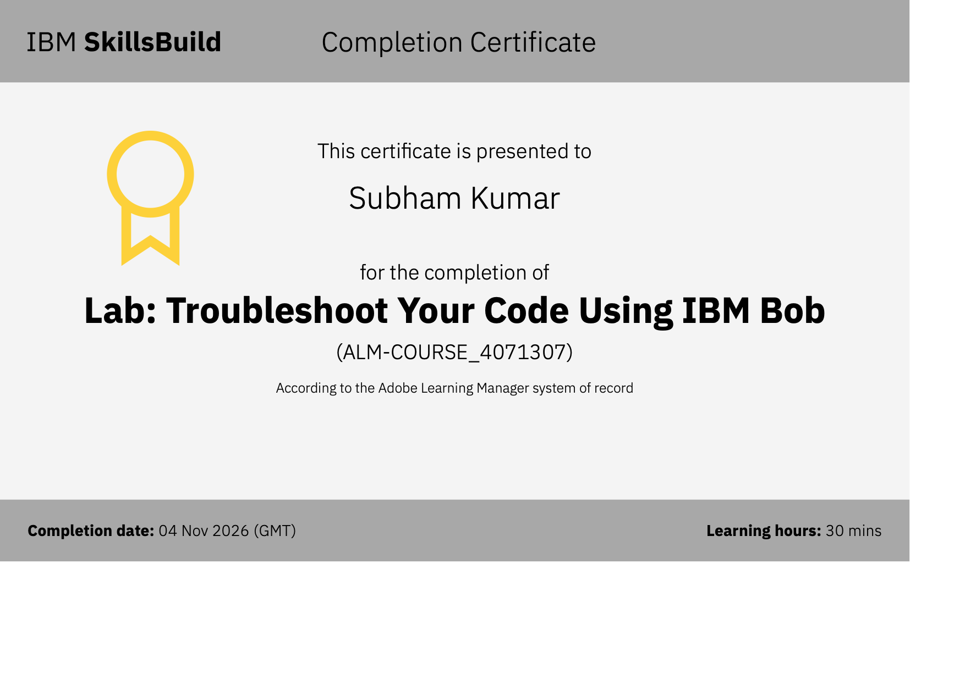
Certificates Earned:​
Add your IBM BOB Certificate

Slide 16


